Slide 1
Final Project Tutorial (Part II)
Yaohua (Tommy) Wang
Department of Electrical and Computer Engineering
University of Iowa

Slide 2
Agenda
Introducing two major Deep Learning Libraries
1. TensorFlow / Keras
2. PyTorch
Introducing Convolutional Neural Network (CNN)
1. Convolutional layer
2. Pooling layer
3. Activation layer
4. Fully connected layer
Build the first neural network
1. Approach Procedure
2. How to improve our model?

Slide 3
Two major Deep Learning Libraries -- TensorFlow
TensorFlow was developed by Google and released as open source in 2015.
The name “TensorFlow” describes how you organize and perform operations on data. The basic data structure for both TensorFlow and PyTorch is a tensor. When you use TensorFlow, you perform operations on the data in these tensors by building a stateful dataflow graph, kind of like a flowchart that remembers past events.

Slide 4
TensorFlow has a reputation for being a production-grade deep learning library. It has a large and active user base and a proliferation of official and third-party tools and platforms for training, deploying, and serving models.
After PyTorch was released in 2016, TensorFlow declined in popularity. But in late 2019, Google released TensorFlow 2.0, a major update that simplified the library and made it more user-friendly, leading to renewed interest among the machine learning community.

Slide 5
Two major Deep Learning Libraries -- PyTorch
PyTorch was developed by Facebook and was first publicly released in 2016.
It was created to offer production optimizations similar to TensorFlow while making models easier to write.
Because Python programmers found it so natural to use, PyTorch rapidly gained users, inspiring the TensorFlow team to adopt many of PyTorch’s most popular features in TensorFlow 2.0.

Slide 6
PyTorch has a reputation for being more widely used in research than in production. However, since its release the year after TensorFlow, PyTorch has seen a sharp increase in usage by professional developers.

Slide 7
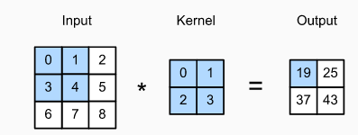
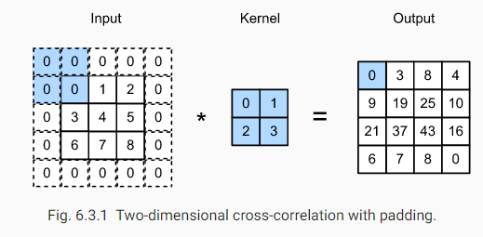
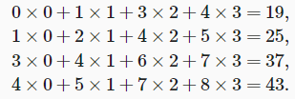
Convolutional Neural Network
Convolutional layer (with Kernel size = 2 × 2 & Stride = 1):
Convolutional Layer w/o padding:
Convolutional Layer w/ padding = 1:

Slide 8
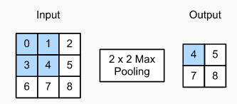
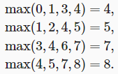
Convolutional Neural Network
Pooling layer (with Stride = 1, Padding = 0):

Slide 9
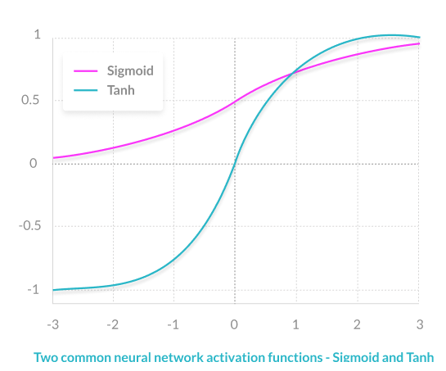
Convolutional Neural Network
Activation Layer:
Activation functions are mathematical equations that determine the output of a neural network. The function is attached to each neuron in the network and determines whether it should be activated (“fired”) or not, based on whether each neuron’s input is relevant for the model’s prediction. Activation functions also help normalize the output of each neuron to a range between 1 and 0 or between -1 and 1.

Slide 10
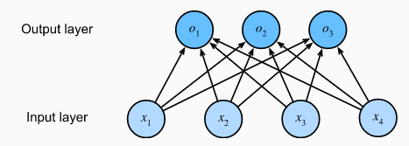
Convolutional Neural Network
Fully connected layer:

Slide 11
Set up the environment and go through the demo
Approach Procedure
How to improve our model?

Slide 12
Approach Procedure
Explore the data
Preprocess the data
Build the model & Set up the layers
Compile the model
Train the model & Feed the model
Evaluate accuracy
Make predictions

Slide 13
How to improve our model?
Learning rate (LR) and Optimizer: Adam or SGD.
Activation functions
Avoid Overfitting: Early stopping strategy
Data augmentation
Network depth vs network width

Slide 14
Learning rate (LR) and Optimizer: Adam and SGD
Adam has a good performance in terms of good convergence speed and good accuracy.
However, Adam in some cases has a worse validation loss than SGD, in other words, Adam though converges fast, may not converge to the optimal minimum as good as SGD does.
https://medium.com/octavian-ai/which-optimizer-and-learning-rate-should-i-use-for-deep-learning-5acb418f9b2
https://towardsdatascience.com/adam-latest-trends-in-deep-learning-optimization-6be9a291375c
https://shaoanlu.wordpress.com/2017/05/29/sgd-all-which-one-is-the-best-optimizer-dogs-vs-cats-toy-experiment/

Slide 15
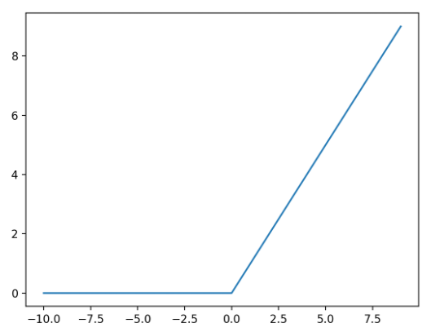
Activation functions
Rectified Linear Unit (ReLU) is considered as a state-of-art good-performance activation function compared with Sigmoid or hyperbolic tangent activation functions since ReLU’s linearity overcomes the vanishing gradient problem which Sigmoid or hyperbolic tangent may encounter during training deep neural network.
https://machinelearningmastery.com/rectified-linear-activation-function-for-deep-learning-neural-networks/

Slide 16
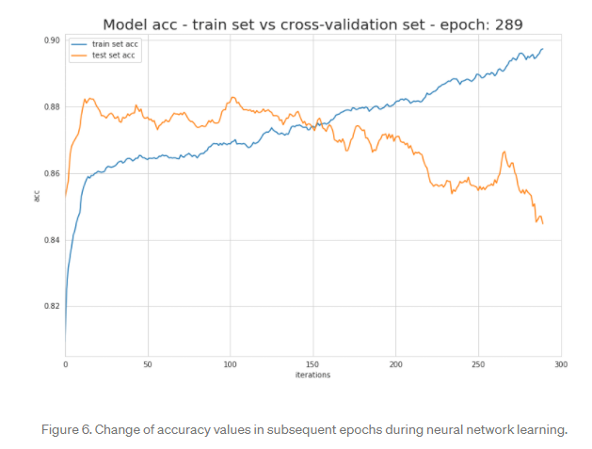
Avoid Overfitting: Early stopping strategy
Training the neural network model too many epochs end up with high variance between training set and testing set, which also called an overfitting problem. Different strategies like L1 and L2 regularization, dropout and early stopping can be used to prevent the model from overfitting.
The idea behind early stopping is that when the generalization error increases, stop training the model to prevent overfitting problem.
https://machinelearningmastery.com/early-stopping-to-avoid-overtraining-neural-network-models/
https://towardsdatascience.com/preventing-deep-neural-network-from-overfitting-953458db800a

Slide 17
Data augmentation
Data augmentation is a good way to enlarge the dataset so that the network trained becomes more robust and achieves better testing accuracy. Data augmentation, in short, is a way that takes a transform, such as rotation, flipping, scale, etc. to the data point to add more artificial created data points to the training set.
Example: https://www.tensorflow.org/tutorials/images/data_augmentation
https://nanonets.com/blog/data-augmentation-how-to-use-deep-learning-when-you-have-limited-data-part-2/
https://www.aiworkbox.com/lessons/augment-the-cifar10-dataset-using-the-randomhorizontalflip-and-randomcrop-transforms

Slide 18
Network depth vs network width
For you to experience

Slide 19
Useful Website
Kaggle

